Slide 1
Building Shiny Web Apps with TypeScript and Angular 2
Dustin Ewers
Consultant @ Centare
Website: www.dustinewers.com
LinkedIn: www.linkedin.com/in/dustinewers
Demo Code: https://github.com/DustinEwers/typescript-demos

Slide 2
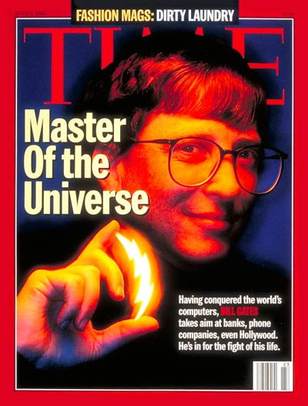
1995
Notes:
1995 had lots of major cultural achievements
Gates = sith lord

Slide 3

1995
Notes:
First computer rendered movie. Took a room of computers, but now could be done on my watch.

Slide 4

1995
Gangster’s Paradise
Notes:
… and Gangsters Paradise
Jagged Little Pill also came out that year.

Slide 5


JavaScript: A History Lesson
Notes:
Brendan Eich
10 days
Standardized in 1996
Purpose: Add dynamic elements to web pages

Slide 6
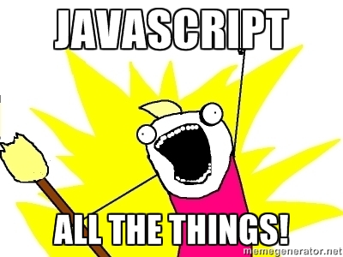
Microcontrollers: Johnny-Five
Servers: Node.js
Command line tools: npm, gulp, etc...
Mobile Apps: Cordova, Ionic
Desktop applications: Electron
VR: Renderloop, Three.js

Slide 7


Slide 8


Slide 9
that’s cool, but…
Notes:
… but there’s a problem
JavaScript isn’t made for the massive apps we use it on

Slide 10


Slide 11
JavaScript: The Lousy Parts
Weird/Unfamiliar Inheritance
No Modules
Dynamically Typed
Horrendous Scoping

Slide 12
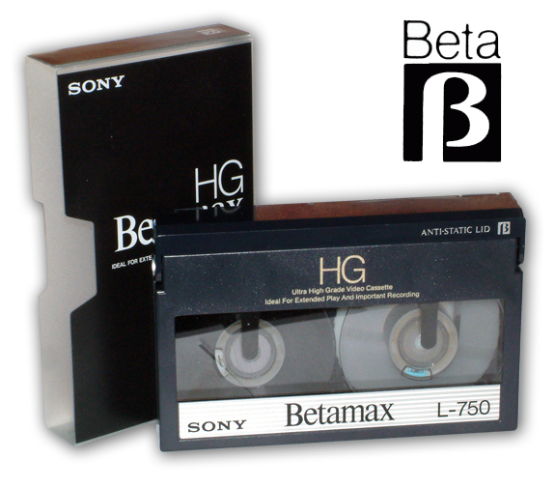
JavaScript == VHS
Notes:
JavaScript is the VHS of the web. Popular, but not that good.

Slide 13
So why are we using JavaScript?
Runs everywhere
Smart People
Amazing Frameworks

Slide 14
Escaping The Fail
Use new JS Today
Use another language

Slide 15
ECMAScript 2015 / ES6
Classes, modules, and scoped variables
Tasty Syntactic Sugar like arrow function and string interpolation
Transpilation (Babel, Traceur)

Slide 16
JavaScript as the New Assembler
There are over 200 different JavaScript compilers.
Notes:
https://github.com/jashkenas/coffeescript/wiki/List-of-languages-that-compile-to-JS
Don’t forget to mention COBOL Script
Popular ones include CoffeeScript and Dart
Other compilers exist for C#, Java, Ruby, etc…

Slide 17
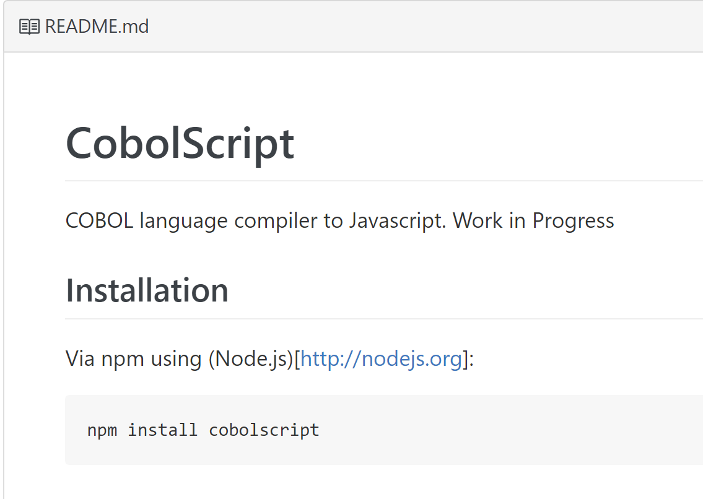
Notes:
https://github.com/ajlopez/CobolScript

Slide 18
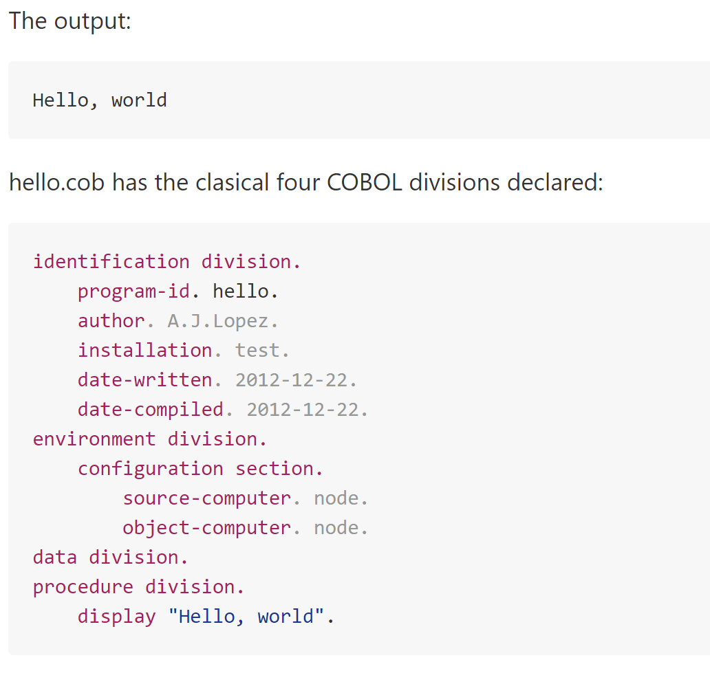

Slide 19
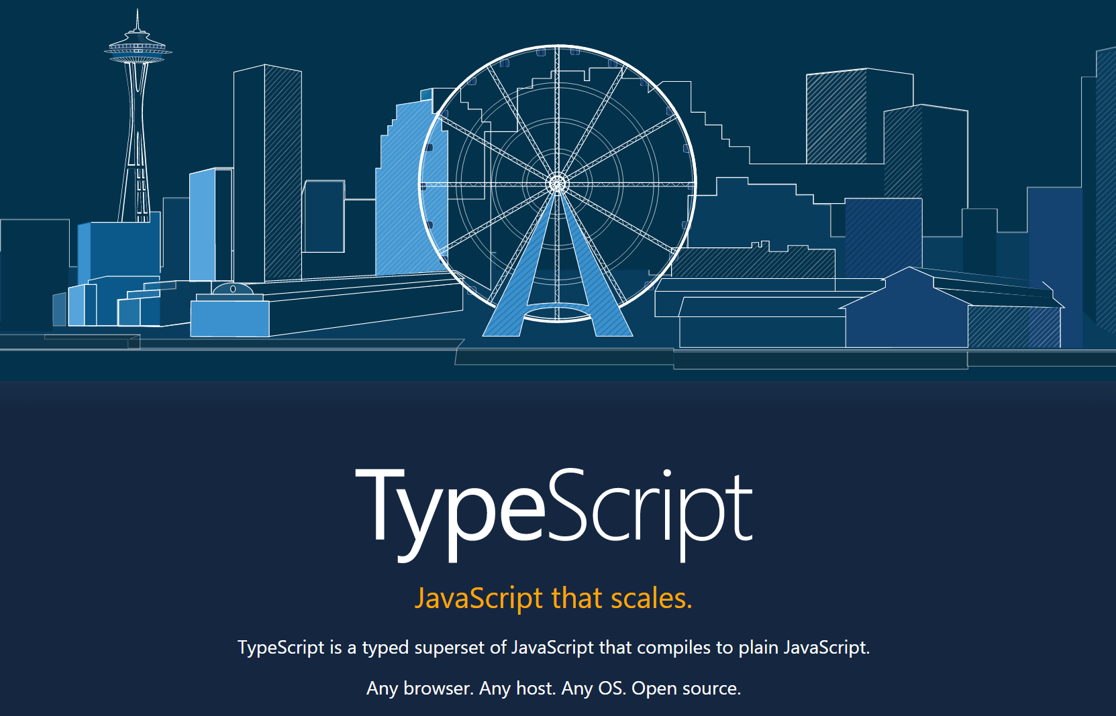
Notes:
https://www.typescriptlang.org/
Kinda in the middle
Superset of JS
ES6/ES7 Features
Optional Static Typing

Slide 20
TypeScript: A brief history
Invented by Microsoft
Released in 2012 (after two years, not 10 days)
Up to Typescript 2.0

Slide 21
Why TypeScript?
It mitigates JavaScript’s primary weakness

Slide 22

Why TypeScript? - Static Typing
Notes:
This allows you to have high quality refactoring tools and compile time error checking.

Slide 23
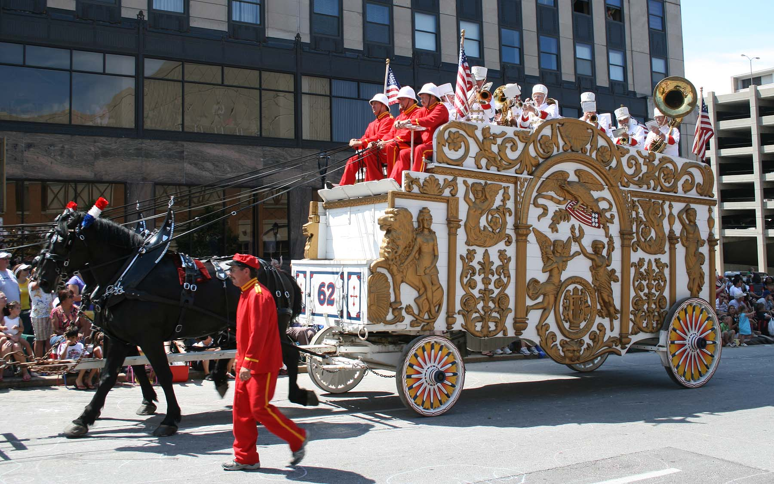
Why TypeScript? – Adoption
15,000+ on GitHub
Over 2 million NPM Downloads
Used by: Microsoft, Angular.js,
Ionic, Telerik, JetBrains,
and many others
Notes:
Angular 2 is written in Typescript
Also, the Azure Dashboard

Slide 24
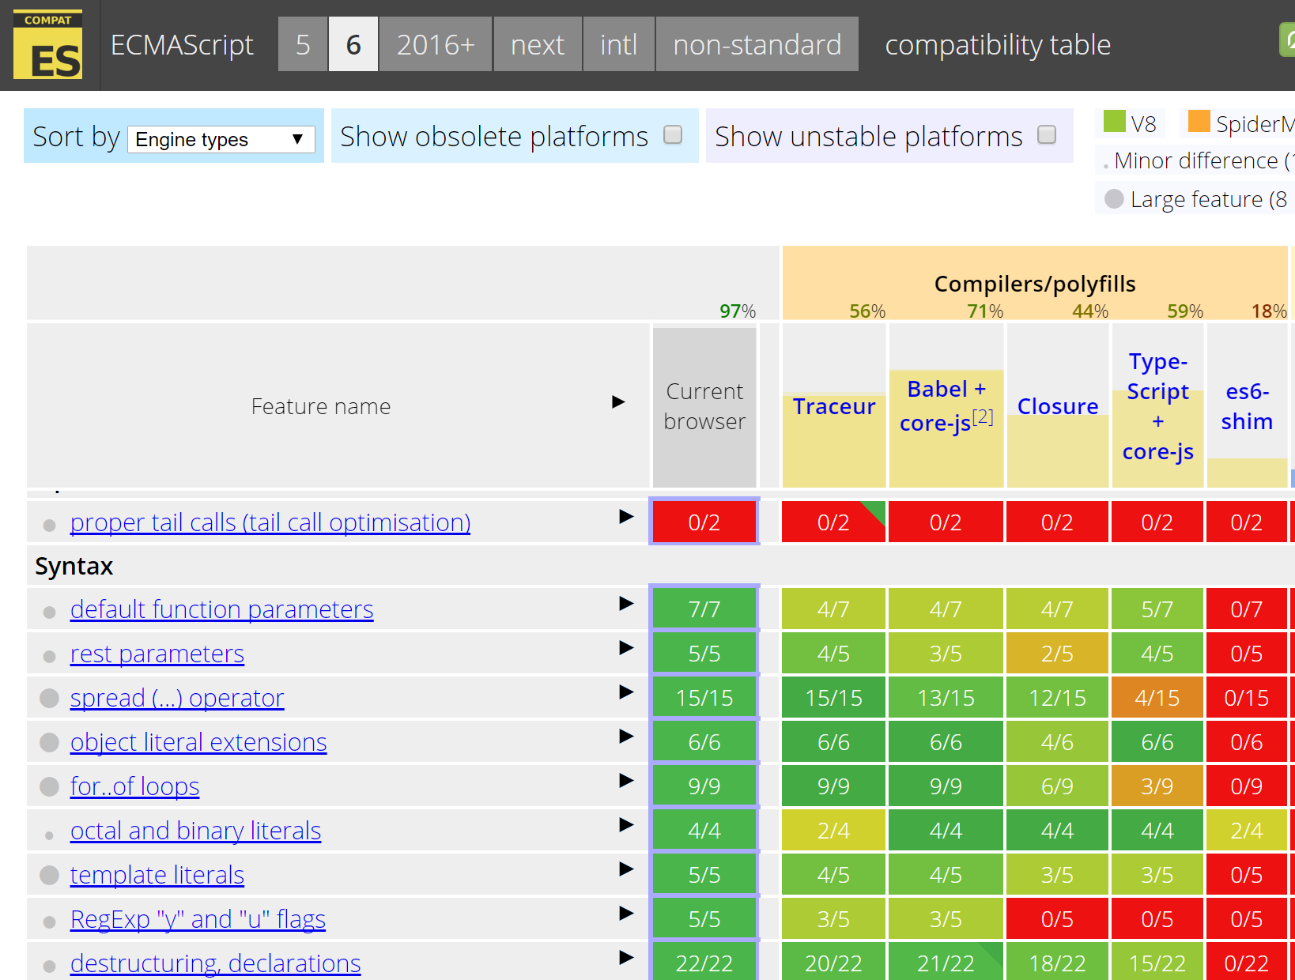
Notes:
http://kangax.github.io/compat-table/es6/

Slide 25
How do I get Started?
TypeScript Playground
TypeScript Handbook
TypeScript Deep Dive

Slide 26
Editors
alm.tools
Atom
CATS
Eclipse
Emacs
NetBeans
Sublime Text
Vim
Visual Studio
Visual Studio Code
WebStorm

Slide 27

Tooling – Visual Studio
Notes:
Rename the files. Visual Studio will compile for you

Slide 28
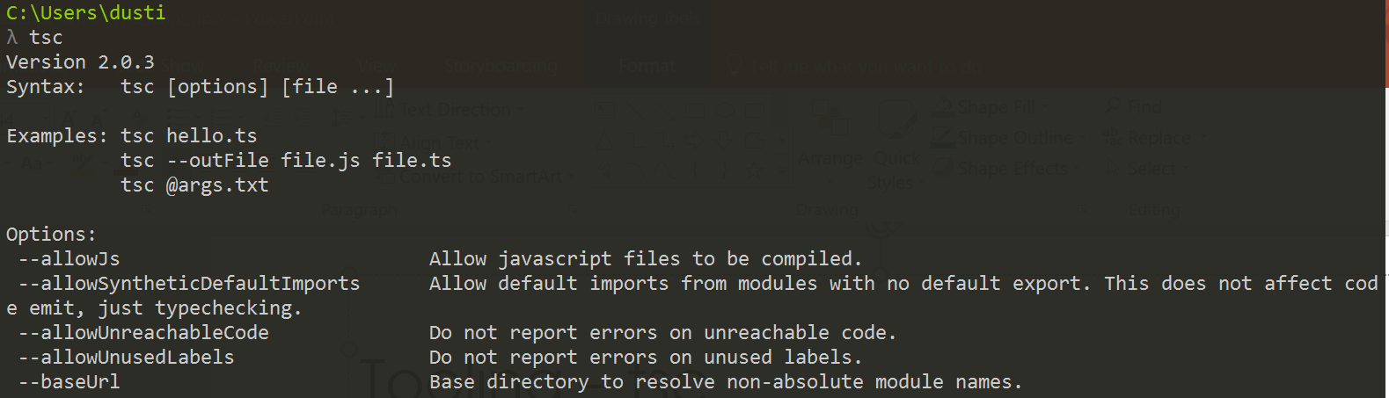
Tooling – tsc

Slide 29
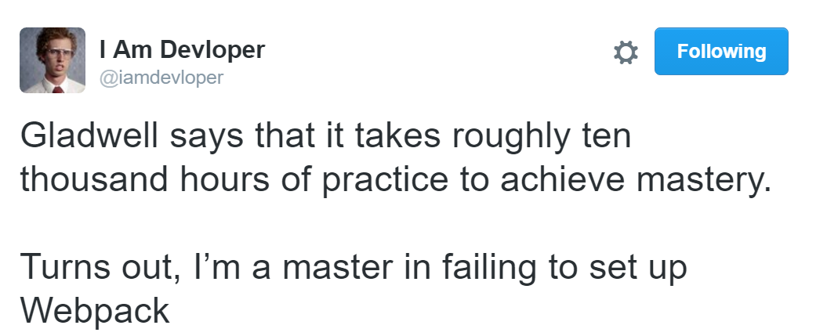
Tooling – Gulp/Webpack/Etc…
Visual Studio
Command Line
Notes:
Webpack is the current default choice for Angular 2 applications

Slide 30
Setup Time Savers
Steve Sanderson’s Angular 2/TypeScript/Webpack template
Angular 2 Webpack Setup
Non Angular 2 Setups:
ASP.NET Core
ASP.NET 4
Gulp / NPM
Notes:
Because JavaScript is a pain in the ass

Slide 31

Angular 2 & TypeScript
Notes:
It’s like PB and Jelly

Slide 32
Why Angular 2?
Build Any Type of App
Good IDE/Tooling Support
Much faster than Angular 1
Notes:
https://angular.io/features.html
Can Build Desktop (Electron), Mobile (Ionic), and Web Apps
Great Visual Studio Support
Among the quickest client side framework

Slide 33
Why Angular 2?
Modular Code
Easy(ish) to Learn
Fully Featured
Notes:
https://angular.io/features.html
Great separation of concerns, built in DI, very testable
Far fewer directives than NG1, don’t need to learn a bunch of extra tools like React
Fully Featured. You don’t have to string together a ton of small tools.

Slide 34
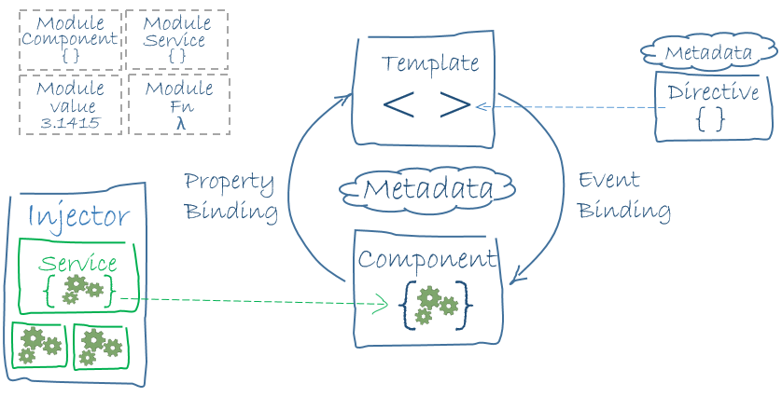
What is Angular 2?
Notes:
https://angular.io/docs/ts/latest/guide/architecture.html
https://angular.io/docs/ts/latest/guide/cheatsheet.html
Angular 2 is an HTML Compiler -> You bind special html and JS together and make a special.
At the Core is Components – which are bound to Templates
Services provide cross cutting functionality
Directives and Pipes - provide some additional functionality to templates

Slide 35
Demos
Notes:
Demo list:
One Page Guide
Basic features
Traditional tooling, tsd files
Ninjas Quest:
Tsconfig,
tslint,
Sass
webpack,
modules,
Ng2 Components,
Ng2 Modules,
Ng2 Services,
Ng2 Routing,
Ng2 Pipes

Slide 36

Major Takeaway
If you’re doing any client side work in .NET, TypeScript & Angular 2 is the logical choice.
Website: www.dustinewers.com
LinkedIn: www.linkedin.com/in/dustinewers
Demo Code: github.com/DustinEwers/typescript-demos

